Slide 1
Towards Dynamic Green-Sizing for Database Servers
University of Waterloo
Mustafa Korkmaz, Alexey Karyakin, Martin Karsten, Kenneth Salem

Slide 2
Data Center Power Consumption
US in 2013
12 million Servers
%2 of all electricity
Keeps Increasing
Notes:
The problem is Data centers consume a lot of power.
According a study in 2013 from Natural Resources Defense Council, there were 12 million servers were in US that operated in data centers in 2013.
(CLICK)These servers consumed around 91 tera watt hour energy. This energy was 2% of all US energy consumption.
(CLICK)And according to projections, power consumption will be increased to 140 tera watts hour in 2020. Which means around 50% increase.
////////////////////////////////////////////////
1) Motivation - data centre power consumption - show how much power data centres consume include an actual stat and graphic to make this point ////////////////////////////////////////////////
Power consumption of data centers has been an important problem for the last decade as the number of servers is increasing rapidly.
In 2013, just in US, there were more than 12 million servers and corresponding electricity consumption was 2% of overall US electricity consumption.
Recent studies also show that the trend in power consumption will continue and 2020 projection shows a 50% increase

Slide 3
Inside a Data Center
Direct Consumption By The Server Is The Largest Component
Servers Must Also Be Cooled
Energy Logic: Reducing Data Center Energy Consumption by Creating Savings that Cascade Across Systems, Emerson Network Power, 2010
Notes:
To understand this substantial amount od power consumption, we looked at the components of data centers. Servers’ direct electricity usage is the largest component.
In addition, the cooling devices consume a big portion of energy, where their purpose is to dissipate the server heat.
Overall, servers are the main electricity consumers, directly or indirectly.

Slide 4
Our Goal
Improve Power Efficiency in DBMS
In-Memory Transactional Workload
Two Parts:
CPU Power Efficiency
Memory Power Efficiency
Analyzing the Energy Efficiency of a Database Server, Tsirogiannis et. al., SIGMOD ‘10
Notes:
In this work, our contribution is to build a more power efficient servers. We focused on two server hardware.
(CLICK)The first one is DBMS-managed dynamic frequency scaling where we scale CPU power according to the varying workload.
(CLICK) And the second one is DBMS managed memory Provisioning, where we balance memory capacity and power consumption tradeoff

Slide 5
Improving CPU Power Efficiency
DBMS-Managed Dynamic Voltage & Frequency Scaling
Slow the CPU at low load to save energy
Speed the CPU at high load to maintain performance

Slide 6
Improving Memory Power Efficiency
Reduce Memory Power Consumption by Allowing Unneeded Memory to Idle
Example: 8 GB DB in 64 GB Server → Up to 56 GB Memory can idle
Not Trivial
Must control Virtual → Physical → DIMM mapping to use as few DIMM’s as possible
Estimation
8 GB DB on 64GB Server→%40 power reduction over default configuration
Details are in the Paper

Slide 7
Talk Outline
Motivation & Introduction
DBMS-Managed Dynamic Voltage Frequency Scaling
Background
Proposed Work
Results
Conclusion & Future Work

Slide 8
Why Power Management in DBMS?
Power is Already Managed
Hardware & Kernel level
DBMS Has Unique Information
Workload characteristics
Quality of Service(QoS): Latency budget
Database characteristics
Size, locality

Slide 9
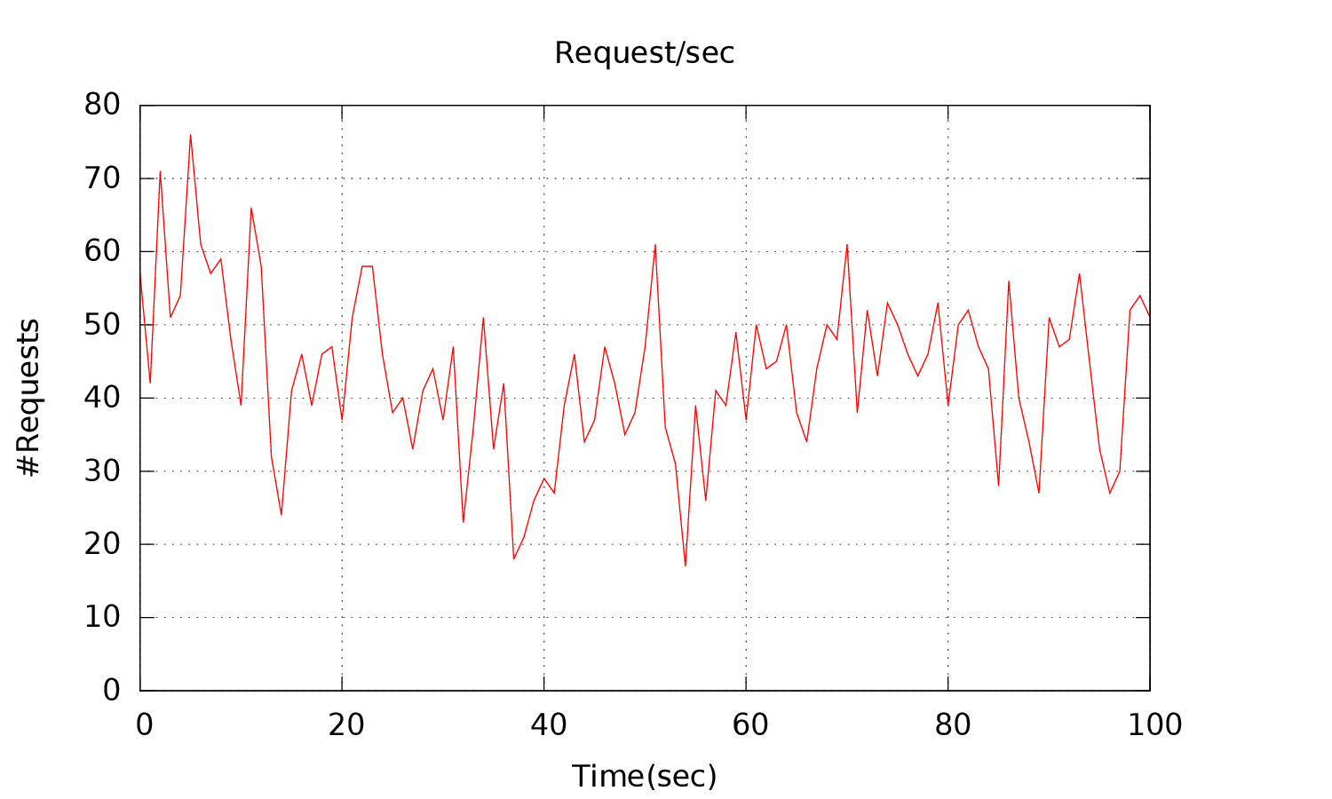
Database Workload
Workload is not Steady
Patterns
Fluctuations, bursts
Systems are Over-provisioned
Configured for the peak load
Lower Loads?
Scale power
http://ita.ee.lbl.gov/html/contrib/WorldCup.html

Slide 10
Dynamic Voltage Frequency Scaling (DVFS)
Recent CPUs Support Multiple Frequency Levels
Can Be Adjusted Dynamically
AMD FX 6300
P-State | Voltage | Frequency
P0 | 1.4 V | 3.5 GHz
P1 | 1.225 V | 3.0 GHz
P2 | 1.125 V | 2.5 GHz
P3 | 1.025 V | 2.0 GHz
P4 | 0.9 V | 1.4 GHz

Slide 11
Existing DVFS Managements
Linux Kernel Supports DVFS Governors
Static, Dynamic Governors
Dynamic Governors
Sample CPU utilization
Difference between samples for decision

Slide 12
DBMS-Managed DVFS
Varying Load
Transaction Latency
Our Approach:
Exploit Latency Budget Except at Peak Load
Slow down the execution
Stay under latency budget

Slide 13
How Slowing Helps
High: 0.07 joule
Low Frequency is More Power Efficient
Low: 0.04 joule
Energy 0.07 joule
Energy: 0.04 joule

Slide 14
How to Scale Power in DB
Set Frequency Before a Transaction Executes
Predict Response Time for Each Waiting Transaction
Select CPU Frequency Level
Stay under latency budget
Slowest possible
Emergency
High number of waiting transaction
Set maximum frequency

Slide 15
DVFS in Shore-MT
Each Worker thread
Has a transaction wait queue
Is pinned to a core
Controls core frequency level
Worker 1
Worker 2
Worker 3
Worker 4
Worker 5
Worker 6
Core 3
Core 4
Core 2
Core 5
Core 1
Core 6

Slide 16
Latency Aware P-State Selection - LAPS
Service Time Prediction
P-State | Time
P0 | 100
P1 | 120
P2 | 150
P3 | 200
P4 | 270
Latency Budget
600
Next P-State
P4
Wait Time
Service Time Prediction
Trx1 For P4: 150+ 270 = 420
Trx 3
Wait: 60
Trx 2
Wait: 130
Trx 1
Wait: 150

Slide 17
Latency Aware P-State Selection - LAPS
Service Time Prediction
P-State | Time
P0 | 100
P1 | 120
P2 | 150
P3 | 200
P4 | 270
Latency Budget
600
Next P-State
P4
P4 is fast enough for Trx1, Check next transaction
Trx 3
Wait: 60
Trx 2
Wait: 130
Trx 1
Wait: 150

Slide 18
Latency Aware P-State Selection - LAPS
Service Time Prediction
P-State | Time
P0 | 100
P1 | 120
P2 | 150
P3 | 200
P4 | 270
Latency Budget
600
Next P-State
P4
Trx2 using P4 = 670
Trx 3
Wait: 60
Trx 2
Wait: 130
Trx 1
Wait: 150

Slide 19
Latency Aware P-State Selection - LAPS
Service Time Prediction
P-State | Time
P0 | 100
P1 | 120
P2 | 150
P3 | 200
P4 | 270
Latency Budget
600
Next P-State
P4
P4 is not Fast Enough! Try next Frequency Level
Trx 3
Wait: 60
Trx 2
Wait: 130
Trx 1
Wait: 150

Slide 20
Latency Aware P-State Selection - LAPS
Service Time Prediction
P-State | Time
P0 | 100
P1 | 120
P2 | 150
P3 | 200
P4 | 270
Latency Budget
600
Next P-State
P4
Trx2 using P3 = 530
Trx 3
Wait: 60
Trx 2
Wait: 130
Trx 1
Wait: 150

Slide 21
Latency Aware P-State Selection - LAPS
Service Time Prediction
P-State | Time
P0 | 100
P1 | 120
P2 | 150
P3 | 200
P4 | 270
Latency Budget
600
Next P-State
P3
P3 is fast enough for Trx2, set next P-State, Check next transaction
Trx 3
Wait: 60
Trx 2
Wait: 130
Trx 1
Wait: 150

Slide 22
Latency Aware P-State Selection - LAPS
Service Time Prediction
P-State | Time
P0 | 100
P1 | 120
P2 | 150
P3 | 200
P4 | 270
Latency Budget
600
Next P-State
P3
Trx3 using P3 = 660
Trx 3
Wait: 60
Trx 2
Wait: 130
Trx 1
Wait: 150

Slide 23
Latency Aware P-State Selection - LAPS
Service Time Prediction
P-State | Time
P0 | 100
P1 | 120
P2 | 150
P3 | 200
P4 | 270
Latency Budget
600
Next P-State
P3
P3 is not Fast Enough! Try next Frequency Level
Trx 3
Wait: 60
Trx 2
Wait: 130
Trx 1
Wait: 150

Slide 24
Latency Aware P-State Selection - LAPS
Service Time Prediction
P-State | Time
P0 | 100
P1 | 120
P2 | 150
P3 | 200
P4 | 270
Latency Budget
600
Next P-State
P3
Trx3 using P2 = 510
Trx 3
Wait: 60
Trx 2
Wait: 130
Trx 1
Wait: 150

Slide 25
Latency Aware P-State Selection - LAPS
Service Time Prediction
P-State | Time
P0 | 100
P1 | 120
P2 | 150
P3 | 200
P4 | 270
Latency Budget
600
Next P-State
P2
P2 is fast enough for Trx3, set next P-State
Trx 3
Wait: 60
Trx 2
Wait: 130
Trx 1
Wait: 150

Slide 26
Latency Aware P-State Selection - LAPS
Service Time Prediction
P-State | Time
P0 | 100
P1 | 120
P2 | 150
P3 | 200
P4 | 270
Latency Budget
600
Next P-State
P2
All Trxs visited, change state to P2
Trx 3
Wait: 60
Trx 2
Wait: 130
Trx 1
Wait: 150

Slide 27
Latency Aware P-State Selection - LAPS
Service Time Prediction
P-State | Time
P0 | 100
P1 | 120
P2 | 150
P3 | 200
P4 | 270
Latency Budget
600
Next P-State
P2
Execute Trx1 under P2
Trx 3
Wait: 60
Trx 2
Wait: 130
Trx 1
Wait: 150

Slide 28
Experimental Setup
System:
AMD FX-6300, 6 cores, 5 P-states , Ubuntu 14.04, Kernel 3.13
Watts up? Power meter
TPC-C
12 Warehouses, Single transaction type: NEW_ORDER
Shore-MT
12 Clients, each issues requests for a different warehouse
6 Workers, a worker per core, 12 GB buffer pool
Experiment Workloads
High, Medium, Low offered load

Slide 29
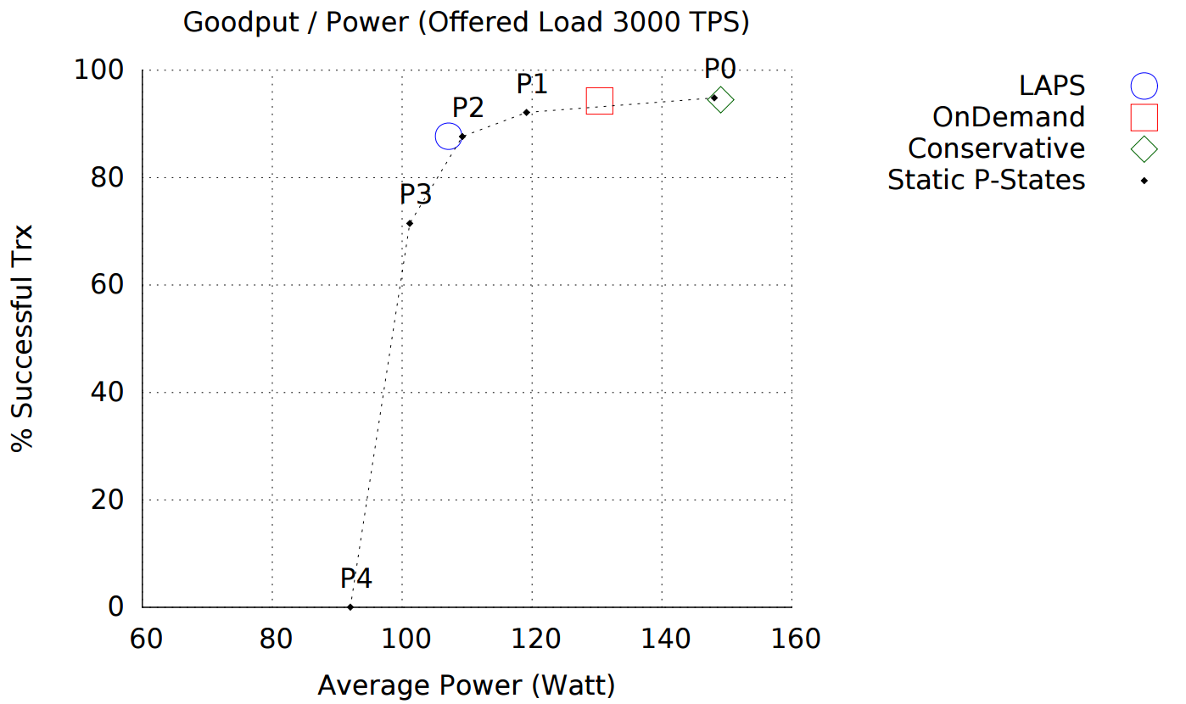
Results – Medium Load
Medium Load
23 W
42W

Slide 30
Results – Frequency Residency

Slide 31
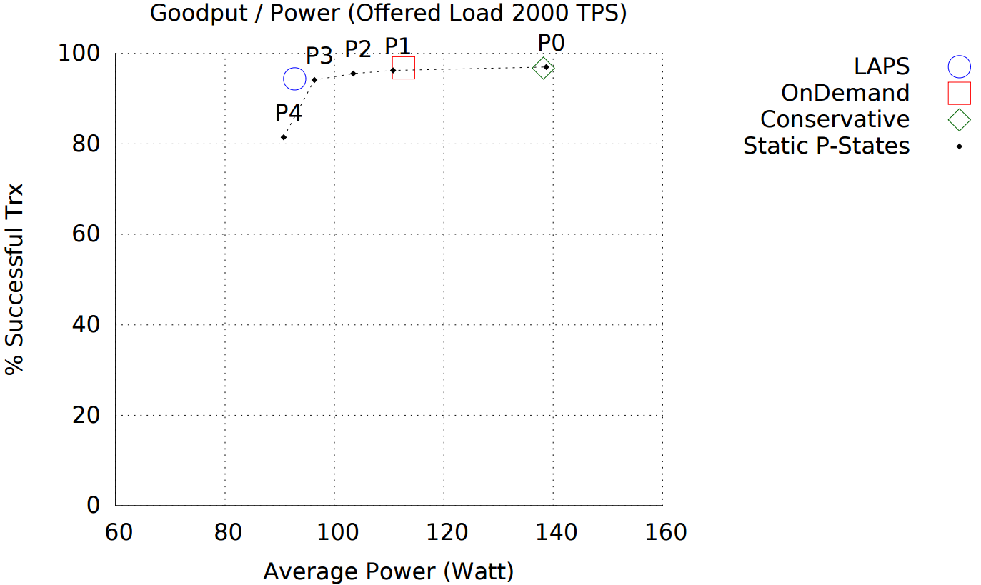
Results – Low Load
Low Load

Slide 32
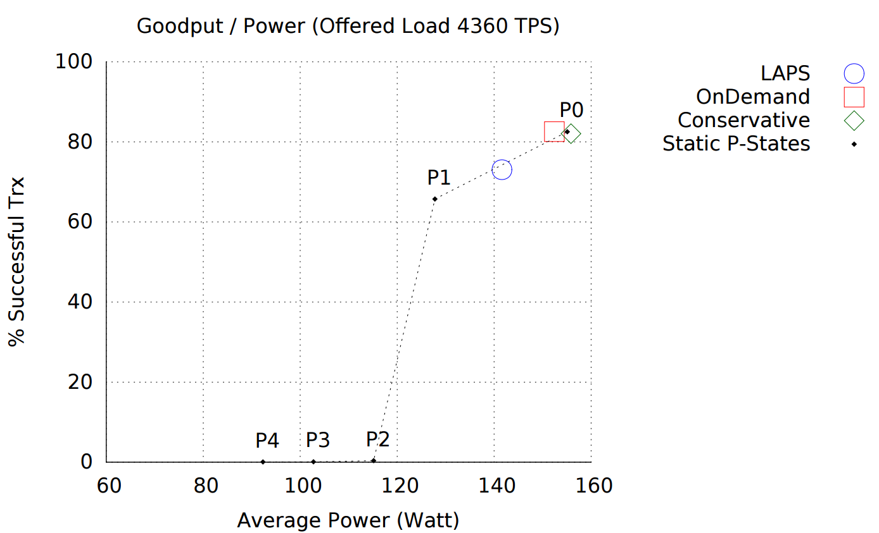
Results – High Load
High Load

Slide 33
Conclusion
DBMS-Managed DVFS
Exploited workload characteristics
Transaction Latency Budget
Reduce CPU power, ensure performance

Slide 34
Future Work
DBMS Managed CPU Power
Better Prediction
Scheduling
DBMS Managed Memory Power
Workload related capacity/performance decision
CPU/Memory Hybrid approach

Slide 35
Thank You
Questions?

Slide 36
Results

Slide 37
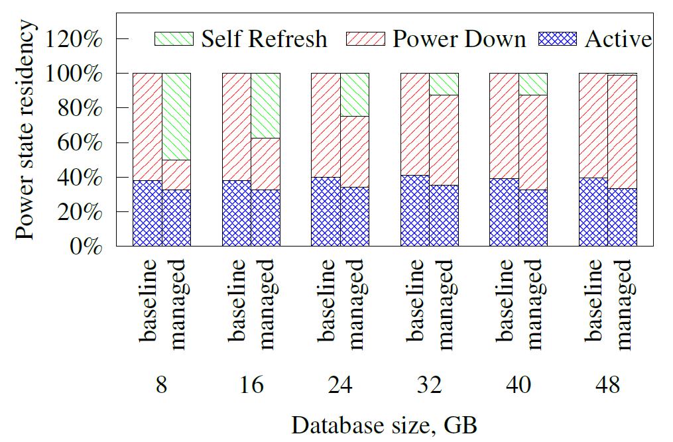
Results -

Slide 38
How slowing helps

Slide 39
Power Model
Operation Power
Memory access operations
ACTIVATE, READ, WRITE
Optimization is in CPU domain (Cache awareness, algorithm design)
Background Power
STANDBY(ACTIVE), POWER-DOWN, SELF-REFRESH

Slide 40
Memory Control Challenges
Default Memory Access: Interleaved
Use all ranks, data is spread
Concurrent, multi-rank read/write
Memory Address
Mapping physical memory ranks to the application

Slide 41
Proposed Work
Our approach
Opportunity in scaling background power
Keep memory ranks in their lowest power state
Non-interleaved
Store data in the selected ranks
Activate ranks with increasing memory
Possible performance degradation

Slide 42
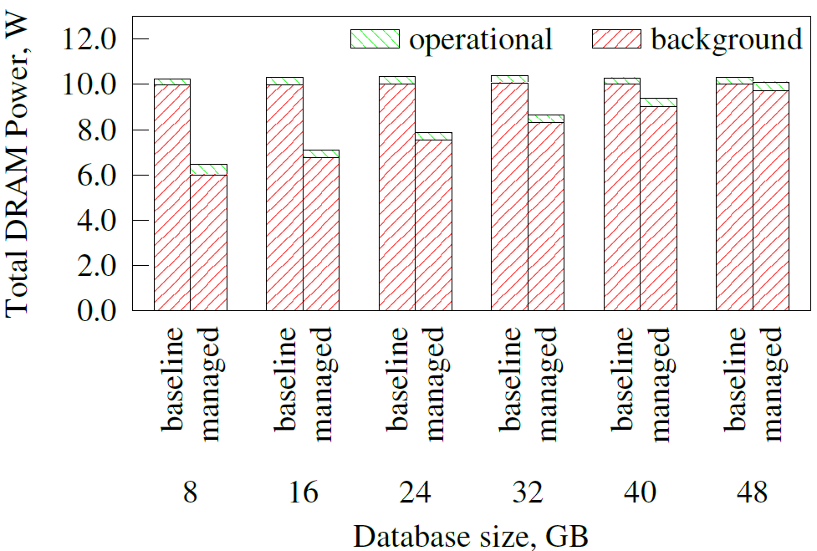
Results – DRAM Power

Slide 43
DVFS in Shore-MT
Each worker
Has a transaction wait queue
Is pinned to a core
Controls core frequency level
Clients
Submit requests to workers
All pinned to a core

Slide 44
Improving CPU Power Efficiency
DBMS-Managed Dynamic Voltage & Frequency Scaling
Slow the CPU at low load to save energy
Speed the CPU at high load to maintain performance

